Slide 1
Reinforcement
Learning

Slide 2
Reinforcement
Learning

Slide 3
based stack

Slide 4

Mobile
Communication

Slide 6

LTE

Slide 8

O-RAN

Slide 9

AWS

Slide 10

EbN0≤min⁡[EbN0]=2γ−1γ{E_b \over N_0} \le \min \left[ {E_b \over N_0 } \right] = {2^\gamma - 1 \over \gamma}N0​Eb​​≤min[N0​Eb​​]=γ2γ−1​
$$C=BW∙\log_{2}{(1+\frac{S}{N})}$$

Slide 11
Minimum required Eb/No [dB]
20
15
10
5
0
-5
10
0.1
1
Bandwidth utilization $\text{γ}$

Slide 12

Minimum required $Eb/No$[dB]
20
15
10
5
0
-5
Power-limited
region
Bandwidth-limited
region
10
0.1
1
Bandwidth utilization $\text{γ}$

Slide 13

GB
$$∆f$$

Slide 14
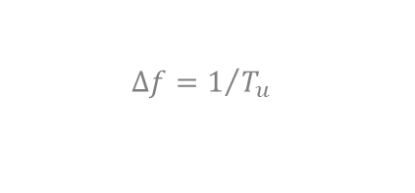
$$∆f=1/{T_{u}}$$

Slide 15

20 MHz
$f_{m}=$ 10 MHz

